Slide 1
Lecture 07 – Remembering
2017.09.06
We Can Remember It for You Wholesale
by Philip K. Dick
Appeared in the April 1966 edition of
The Magazine of Fantasy and Science Fiction,
and the inspiration for the movie Total Recall
Notes:
Bring to class: Pentium chip, 7400 data sheet, ABE 5-pole, 25-throw switch

Slide 2
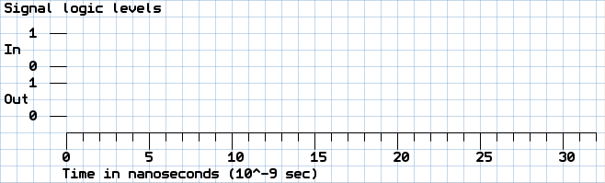
Announcements
If the least significant digit of your PU ID is even, then pick up a Signal Logic Level graph on the desk in the front of the room

Slide 3
Assignment for Week 03
Lab 02 – Analog, bouncy, and de-bounced inputs
HW 02 due Thursday
Re-read textbook Chaps 1 and 2
Read chapters 4 and 5
Notes:
15 clickers recorded, but without associated student name

Slide 4
What capability to implement next?
Circuit that can ADD can readily be extended to execute instructions generally: subtract, compare, …
Goal: Hardware that can store and execute our programs autonomously
Must have hardware memory to store programs and allow their instructions to be read by and execution circuit

Slide 5
Gate specifications (specs)
To ensure gate operation in a wide variety of environments, extensive engineering and measurement performed
Gate speed is always of interest
Propagation delay – elapsed time from a gate input change until a gate output change
May not be symmetric: Low to high transition T_{PLH} may take longer than H to L, T_{PHL}, or vice versa
Input changes that do not cause an output change do not define T_{PLH} or T_{PHL}

Slide 6
Look 7400 NAND Data Sheet (specs)
Here is the data sheet from Texas Instruments

Slide 7
Logic Circuits
Combinatorial logic – implements functions of logic inputs to generate a result or output (defined by its truth table)
Nice, but a logic circuit will be more powerful if its output can also be a function of time
What does it mean for a function to include time as an input? For a circuit?
Function and circuit behavior will depend on HISTORY

Slide 8
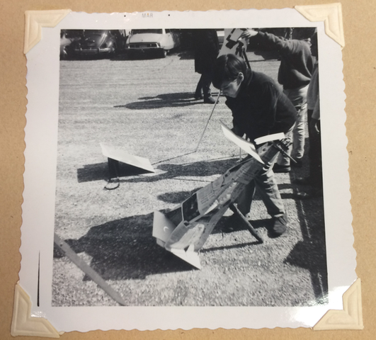
“One time a guy handed me a picture, he said, ‘Here’s a picture of me, when I was younger.’
Every picture of you is when you were younger!” – Mitch Hedberg, paraprosdokian comedian
This photo is a memory.
How can we build a circuit with memory?
Me, watching the total solar eclipse
of March 07, 1970

Slide 9
Very recent history, a video example
I clap my hands so that you can both
look directly at them to see them moving, and
see them moving in the projected video
Video is a fraction of a second delayed compared to what your eyes see directly
You could say that my video is HISTORIC
Video is history because of signal propagation time in the document camera and projector circuits

Slide 10
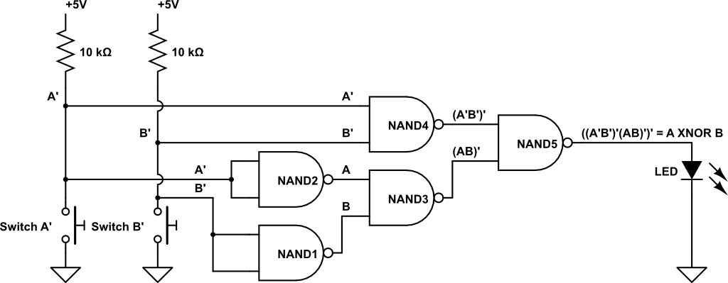
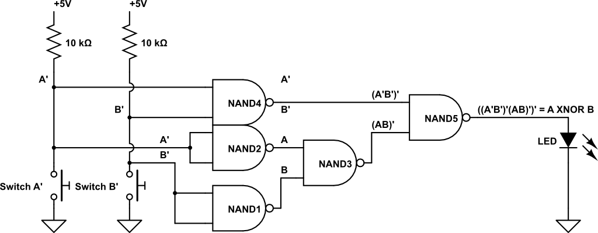
History as location
We can go looking for history in digital circuits
Where is history in our Lab 01 circuit?
Let inputs = Now →
Here is response to the
inputs of
10ns ago
Here is →
20ns ago
Here is → 30ns ago
Here is → 35ns ago
Notes:
First cut at timing depicting needs a tweak. Circuit tweaked by moving NAND4.

Slide 11
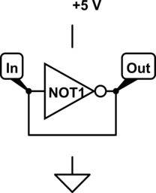
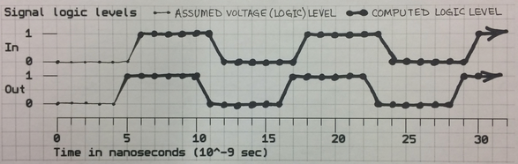
Memory is history, recalled
Gate output is a function of historic input(s)
How can a circuit recall its output?
Use feedback: connect output to input
Look at simplest example, using one NOT gate: Assume IN=Out=0 at time = 0, and gate propagation delay = 5 ns and wire propagation delay = 1 ns
Plot IN and OUT logic values as functions of time
Notes:
Generate plot together in class.
Use an ink pen if you have it. If using pencil, do not erase. Write name and PUID on paper

Slide 12

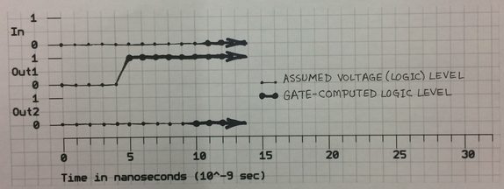
Try again
Want memory, not oscillator; try 2 inverters in series

Slide 13
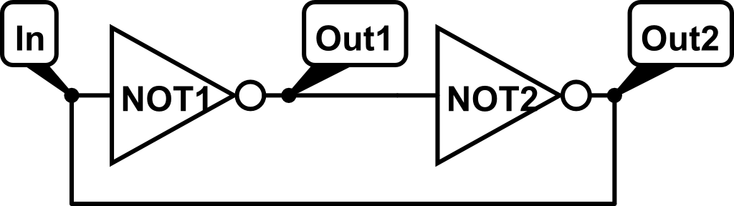
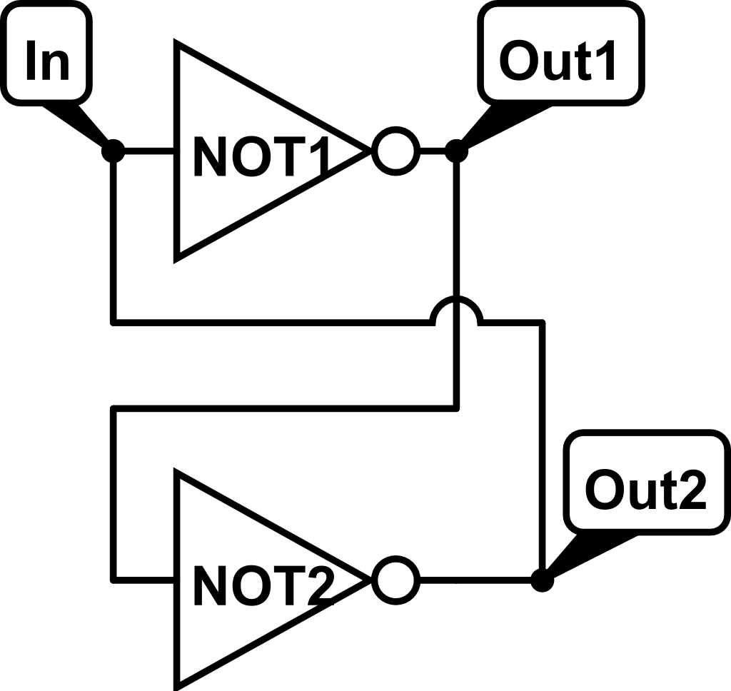
Two ways to diagram a feedback loop
Circular
Twisted

Slide 14
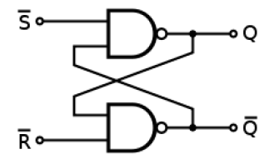
Now control the starting condition
Use NAND as inverter most of the time
A zero input will force a “starting condition”
Two inputs: Set, S, makes output Q=1 and Reset, R, makes output Q=0
S’ and R’ because these inputs are active low

Slide 15
Set-Reset (SR) latch
Text figure 2.14 contains a basic feedback circuit of two NAND gates with each output connected to an input of the other gate
Related, in a sense, to recursion
Feedback of a circuit output (history of action) to an input carries that history of a circuit back to the present (a circuit input)
Bringing historic information to the present is MEMORY
Analyze the S’R’ two-NAND-gate feedback circuit in time

Slide 16
Mechanical switch terminology
Pole – number of separate circuits controlled by a single actuator; one “pole” per circuit
Often convenient to “gang” switches of several circuits into a single actuator
Control many with one action
Throw – number of connection path choices, other than OPEN, for each pole
Only “gang” circuits that need the same number of connection choices
The moving part of a switch implements the throws
Notes:
Look at disassembled PUSHBUTTON switch

Slide 17
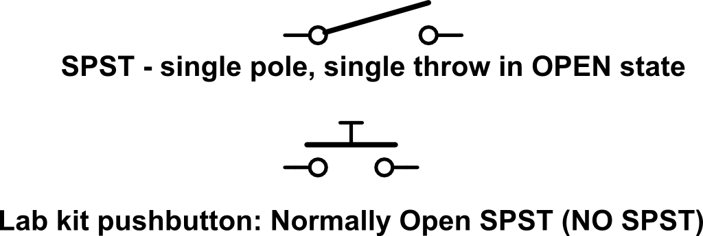

Switch examples
Single-pole, single-throw (SPST)
Single-pole, double throw (SPDT)

Slide 18
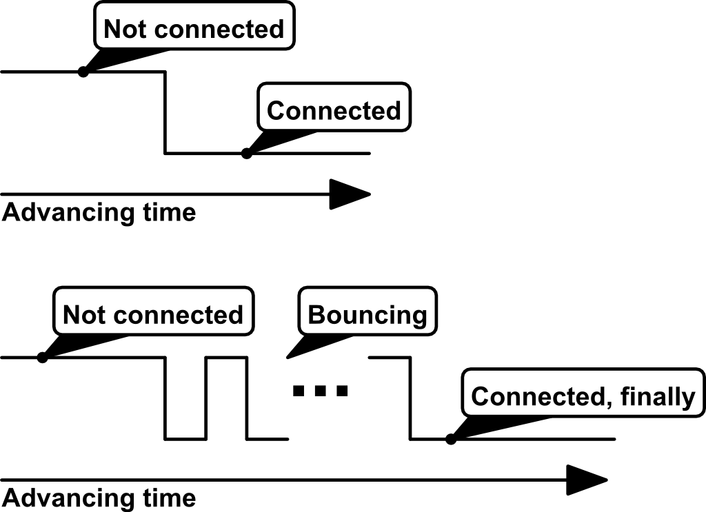
Mechanical switches “bounce”
When the moving “throw” makes contact with one of the connection choices, that mechanical interaction usually bounces

Slide 19
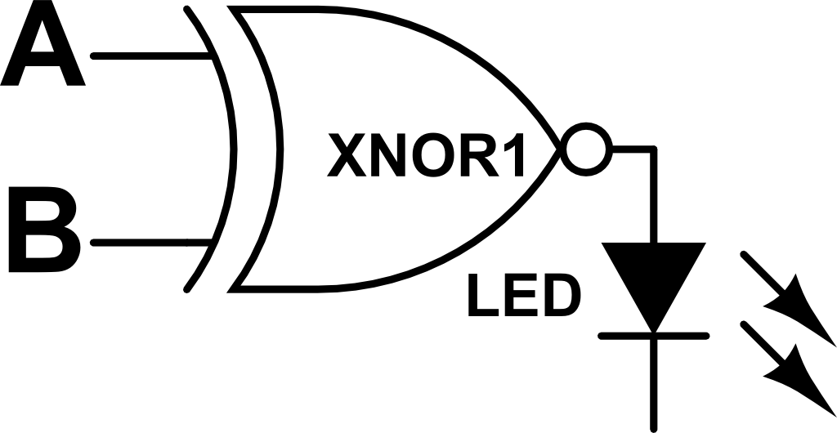
What the LED in Lab 01 really does
Lab 01 circuit has mechanically switched inputs driving the logic defined by the circuit and table
Imagine switches for A and B not pushed, A=B=1
Now push switch for B, which bounces, e.g., 11101010000, then from truth table LED goes (initially) Off, On, Off, On, Off, On (now stable)
A | B | A XNOR B | LED
0 | 0 | 1 | On
0 | 1 | 0 | Off
1 | 0 | 0 | On
1 | 1 | 1 | Off

Slide 20
Look at SR latch in Lab 02
SR latch is a 1-bit memory
Characteristic table, below left
Excitation table, right
S’ (active low) | R’ | Q(t) | Q(t+1)
1 | 1 | X | Q(t)
0 | 1 | X | 1 (set)
1 | 0 | X | 0 (reset)
0 | 0 | X | Not allowed
Q(t) | Q(t+1) | S’ | R’
0 | 0 | 1 | X
0 | 1 | 0 | 1
1 | 0 | 1 | 0
1 | 1 | X | 1

Slide 21
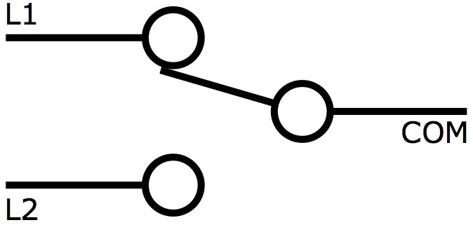
SR latch,Lab 02
+5 V
+5 V
a, contact S’
b, no contact
c, contact R’
Using a single-pole, double-throw switch to drive S’ and R’ inputs
S’ (active low) | R’ | Q(t) | Q(t+1)
1 | 1 | X | Q(t)
0 | 1 | X | 1 (set)
1 | 0 | X | 0 (reset)
0 | 0 | X | Not allowed
Q(t) | Q(t+1) | S’ | R’
0 | 0 | 1 | X
0 | 1 | 0 | 1
1 | 0 | 1 | 0
1 | 1 | X | 1
b, c
a
b, c
a
b, a
b, a
c
c
Simultaneous a and c
mechanically impossible
by design

Slide 22
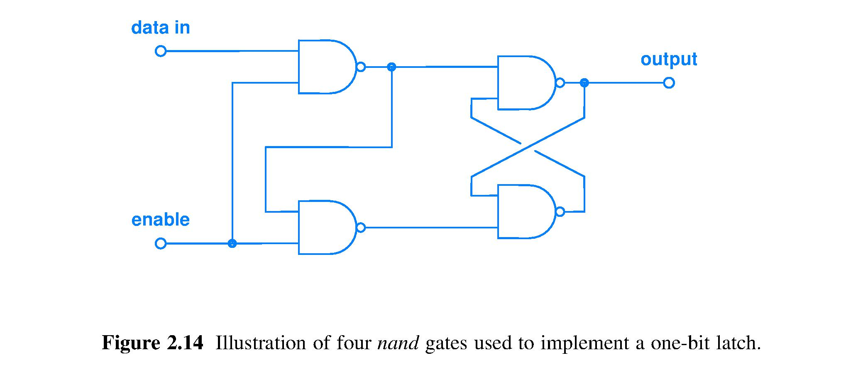
Data latch
Build on the SR latch idea for more useful operational characteristics
Fig. 2.14 when Enable momentarily goes high, circuit samples value of Data In and stores it in SR latch and presents that value on Output

Slide 23
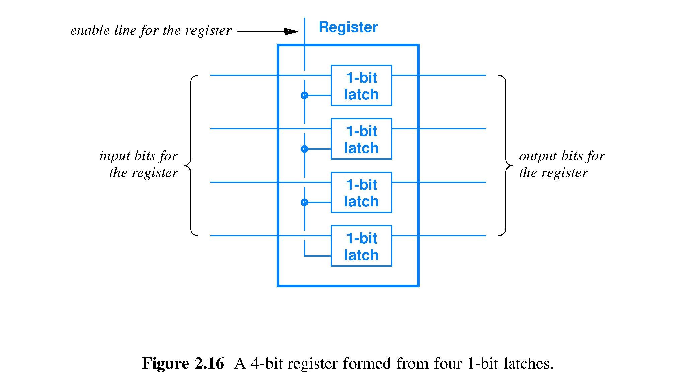
Register – fast storage of a bit string

Slide 24
Summary
Half-adder to a 64-bit ripple carry adder: hardware handles wider data through replication of circuits for one-bit data
Feedback is a fundamental circuit concept
Used to build a circuit with memory
Used to
Basic memory circuit is the Set-Reset latch
Using a latch solves the bouncing mechanical switch problem
A collection of latches can form a register

